Slide 1
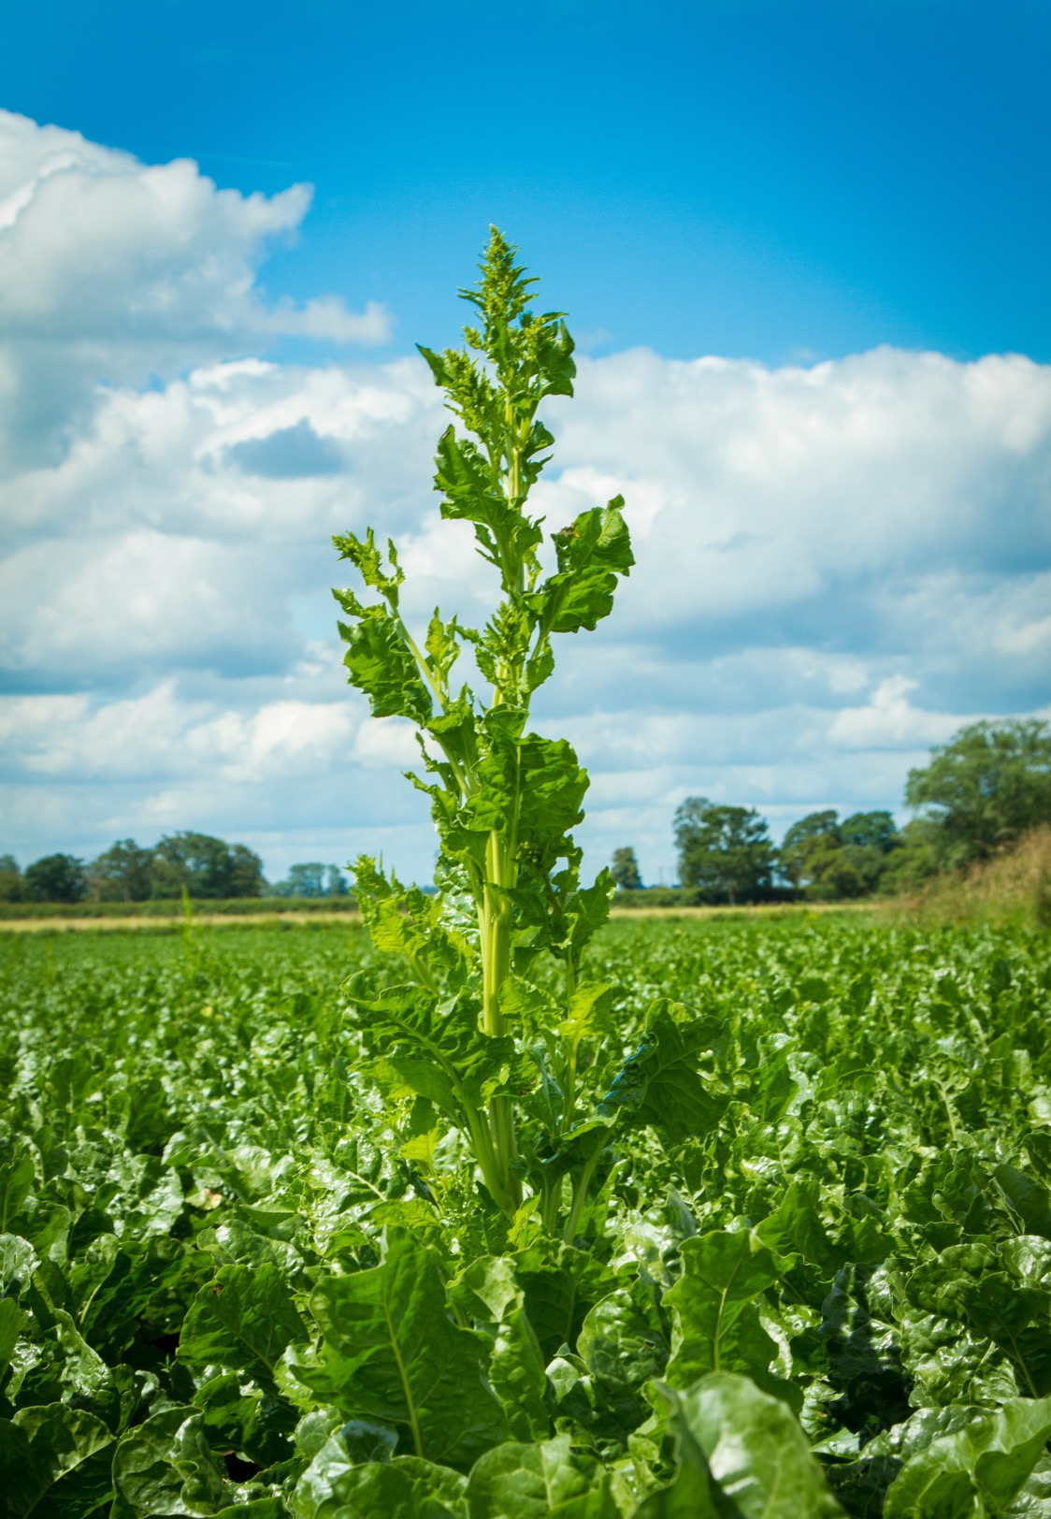
Removal of bolters
in sugar beet crops
Stewardship guidelines for manual workers
Guidelines to protect workers hand-pulling bolters and weed beet from sugar beet crops were first being introduced in 2018. As one of the leaders in crop protection products, Bayer continually re-evaluates industry practices. Today, as a field worker you are often required to work in sugar beet crops for long periods.
These guidelines have been introduced to protect you from the associated potential exposure to chemical residues.
Wherever possible, complete hand-pulling before the field is sprayed.
If a field has been sprayed within the previous 48 hours do not enter to work.
Between 48 hours and 6 weeks after spraying, re-enter the field to work ONLY if clothed in appropriate workwear – that is boots, gloves and long trousers – and waterproof trousers if the crop is wet. Wear suitable protective gloves that meet at least glove safety standard: EN374-1:2016 Type A and EN388:2016 (3 1 2 1 x) e.g.: Uvex types 7156 and 67543. Frequently replace gloves and discard if torn or damaged. Contaminated gloves should be washed as soon as possible in water. Always wash gloves before removal.
After 6 weeks from spraying there are no requirements.
Please work to these guidelines this summer that are to ensure your safety at work. A recording template is available at www.cropscience.bayer.co.uk/beet-cropworker-template
Use plant protection products safely. Always read the label and product information before use.
Pay attention to the risk indications and follow the safety precautions on the label. For further information,
please visit www.cropscience.bayer.co.uk or call 0808 1969522. © Bayer CropScience Limited 2018

